Slide 1
THE PRACTICE OF
PHYSICAL AI
Landscape, Commercialization, Competition, and the Industrial-AI Bridge
CONFIDENTIAL AND PROPRIETARY

Slide 2
THE CORE STRATEGIC THESIS
Physical AI is the shift from predicting the next token to intervening in the next moment of physical reality.
From autoregressive prediction in static semantic space, to closed-loop causal control of continuous physical dynamics - sensed, acted on, and corrected at machine speed.
CONFIDENTIAL AND PROPRIETARY

Slide 3
EXECUTIVE SUMMARY
Three facts that define the opportunity
$3.2B+
<$20M
Bridge
LAST 18 MONTHS
ACROSS ALL VENDORS, COMBINED
THE STRATEGIC THESIS OF THIS BRIEFING
Venture capital into humanoid & robotics foundation model startups
Industry-wide commercial revenue from unconstrained humanoid deployments
LTTS's highest-conviction play: certified systems integration, V&V, and synthetic data - not hardware, not foundation models
VERIFIED
ESTIMATED
SPECULATIVE
Capital is subsidizing hardware experimentation while the durable margin sits in software, verification, and integration - where LTTS already competes.
CONFIDENTIAL AND PROPRIETARY

Slide 4
01
CURRENT STATE
Commercial Maturity Mapping
Three operational tiers, from paid production to lab-only demos
Disclosed venture capital by sub-segment, 2024–2026
The capital vs. maturity asymmetry — and what it means for LTTS
CONFIDENTIAL AND PROPRIETARY

Slide 5
SECTION 01 · CURRENT STATE
Commercial maturity tiers
TIER 1
TIER 2
TIER 3
Production at Scale
Active Customer Pilots
Lab Demonstrations
Continuous revenue, core workflows
Pre-production, bounded environments
Research claims, no scale deployment
Waymo - 150,000+ paid robotaxi trips/week
Figure AI - Figure 02 at BMW Spartanburg
Zero-shot <0.1mm precision assembly
VERIFIED
VERIFIED
SPECULATIVE
Applied Intuition / NVIDIA Isaac Sim - ADAS validation
Apptronik - Apollo at Mercedes-Benz
Unstructured multi-step domestic tasks
VERIFIED
VERIFIED
REPORTED
TSMC - automated defect classification
Boston Dynamics - Stretch at DHL Supply Chain
REPORTED
VERIFIED
CONFIDENTIAL AND PROPRIETARY

Slide 6
SECTION 01 · CURRENT STATE
Disclosed capital by segment
2024–2026 · disclosed funding rounds, aggregated by sub-segment
Robotics Foundation Models & Humanoids
Leaders: Wayve · Figure AI · Physical Intelligence · 1X
PILOT / EARLY PRODUCTION
Simulation & Digital Twin Platforms
Leaders: Applied Intuition · Scale AI · World Labs
PRODUCTION
Industrial Automation AI (Fixed & Mobile)
Leaders: Skild AI · Bright Machines · Covariant
PILOT / PRODUCTION
Robotics Safety & Compliance Tooling
Leaders: Credo AI · Holistic AI
PILOT
VERIFIED
CONFIDENTIAL AND PROPRIETARY

Slide 7
SECTION 01 · CURRENT STATE
The capital vs. maturity asymmetry
THE HUMANOID CAPITAL TRAP
$2.2B
<$20M
VS
DEPLOYED INTO HUMANOID OEMs
CUSTOMER REVENUE, INDUSTRY-WIDE
Over the last 18 months, across general-purpose humanoid hardware vendors
Verified commercial production revenue across the entire humanoid sub-segment, all vendors combined
VERIFIED
ESTIMATED
Implication for LTTS: capital is aggressively subsidizing hardware experimentation. The durable position is upstream - as the integration and testing partner that earns service revenue regardless of which hardware vendor wins.
CONFIDENTIAL AND PROPRIETARY

Slide 8
02
RESEARCH DIRECTION
What the Frontier Is Actually Working On
Five active engineering bottlenecks across frontier labs
The five canonical world-model failure modes — and what mitigates each
Why Pearl's Causal Ladder explains the LLM-robotics failure
CONFIDENTIAL AND PROPRIETARY

Slide 9
SECTION 02 · RESEARCH DIRECTION
Five technical priorities at the frontier
Published technical direction across Physical Intelligence, Google DeepMind, NVIDIA GEAR, Stanford IRIS, UC Berkeley BAIR, and Toyota Research Institute
1
2
3
4
5
Continuous Flow Matching
3D Physics-Informed World Models
Reinforced Fine-Tuning
Cross-Embodiment Scaling
Edge Model Compression
50Hz continuous control trajectories, replacing discrete action tokens (π0, ManiFlow)
Voxel and point-flow representations replace 2D pixel prediction for contact and collision
RL sub-goal rewards and residual policies correct imitation-learning drift
Log-linear scaling pre-training on egocentric human video (NVIDIA EgoScale, 2026)
Channel-aware quantized VLAs run deterministically on Jetson AGX Orin
CONFIDENTIAL AND PROPRIETARY

Slide 10
SECTION 02 · RESEARCH DIRECTION
Five canonical world-model failure modes
FM1
Compounding Autoregressive Drift
Hierarchical state models, receding-horizon MPC, flow matching
Minor per-step errors multiply exponentially over long rollouts
Partially solved on benchmarks
FM2
The Executability Gap
Physics-informed loss constraints, differentiable physics engines
Generated frames violate real contact physics
Gaining traction in simulation tooling
FM3
Perceptual Hallucination
Latent reconstruction residual gating
Out-of-distribution inputs mapped to incorrect known tokens
Active research; critical for safety
FM4
Action Marginalization
Action-conditioned contrastive losses, inverse dynamics heads
Predictions become invariant to real-time operator input
Active research in foundation labs
FM5
Sim-to-Real Reality Gap
Real2Sim2Real closed loops, hybrid synthetic-plus-real data
Mismatches between simulation dynamics and real-world friction
Standard industrial engineering practice
CONFIDENTIAL AND PROPRIETARY

Slide 11
SECTION 02 · RESEARCH DIRECTION
Why LLMs fail at robotics - Pearl's Causal Ladder
P(Yᵤ | X', Y')
Safe execution requires evaluating alternative physical paths before acting.
RUNG III
Counterfactuals & Planning
P(Y | do(u))
Physical control requires predicting the effect of a specific action - e.g. a 15N torque applied to an object.
RUNG II
Intervention & Action
P(Y | X)
Language models operate on observational correlation - the most probable next token given history.
RUNG I
Association & Observation
This causal distinction is why industrial robotics requires dedicated world models and physics-grounded verification — not raw prompt engineering on LLMs.
CONFIDENTIAL AND PROPRIETARY

Slide 12
03
COMMERCIALIZATION
How Physical AI Generates Revenue
Five commercial models and their deal economics
LTTS's four-offering engineering services playbook
CONFIDENTIAL AND PROPRIETARY

Slide 13
SECTION 03 · COMMERCIALIZATION
Commercial models & deal economics
LTTS LANE
Model Licensing / FMaaS
Full-Stack OEM (HW + SW)
Simulation & Validation Tooling
Compliance & Safety Verification
Systems Integration & Deployment
Physical Intelligence · Skild AI · Covariant
Figure AI · Agility Robotics · Boston Dynamics
NVIDIA Isaac · Applied Intuition
TÜV SÜD · UL Solutions · Credo AI
LTTS · KPIT Tech · Accenture Industry X
$100K–$500K+
$5K–$15K
$250K–$2.0M+
$150K–$750K
$1.0M–$8.0M+
annual license + overage
/robot/mo (RaaS) or CapEx + SLA
enterprise SaaS ACV
audit fee + subscription
per site, T&M + milestone
SALES CYCLE
SALES CYCLE
SALES CYCLE
SALES CYCLE
SALES CYCLE
3-6 mo
12-18 mo
6-9 mo
6-12 mo
4-8 mo
BUYER
BUYER
BUYER
BUYER
BUYER
VP Software / Head of Robotics R&D
GM / VP Logistics
VP Engineering / Autonomous Systems
Chief Safety Officer
CIO / VP Manufacturing
CONFIDENTIAL AND PROPRIETARY

Slide 14




SECTION 03 · COMMERCIALIZATION
LTTS's four service offerings
The engineering services playbook — capital-light, service-heavy, hardware-agnostic
Synthetic Data Factory as a Service
Brownfield PLC-to-AI Integration
Ingest client CAD/PLM assemblies into calibrated Isaac Sim digital twins to train synthetic policies
Deterministic middleware bridging neural outputs to Siemens S7-1500 / Rockwell ControlLogix with safety interlocks
$1.0M–$3.5M / annual engagement
$1.5M–$5.0M / plant rollout
Physical AI Verification & Validation
Managed Embodied MLOps
Independent stress-testing of third-party neural controllers against ISO 13849 and IEC 61508
Continuous telemetry monitoring, edge drift detection, automated synthetic retraining pipelines
$500K–$1.5M / engagement
$500K–$2.0M / annual recurring
CONFIDENTIAL AND PROPRIETARY

Slide 15
04
USE CASES & ADOPTION
Production Reality vs. Hype
Verified production deployments across five sectors
Hype-ahead-of-deployment categories — and the concrete reason why
CONFIDENTIAL AND PROPRIETARY

Slide 16





SECTION 04 · USE CASES & ADOPTION
Verified production deployments by sector
Automotive
Aerospace & Defense
Semiconductor
Logistics & Warehousing
Energy & Utilities
Optical/acoustic QC at BMW, Ford, Mercedes; sheet-metal handling under fixed fixtures
Composite layup inspection and robotic drilling guidance on Airbus and Boeing programs
Physics-informed defect prediction across lithography stages at TSMC and Intel
Stretch trailer unloading at DHL; AMR fleets at Amazon Robotics and Symbotic/Walmart
Predictive thermal and vibration monitoring on heavy gas turbines — GE Vernova, Siemens Energy
VERIFIED
REPORTED
REPORTED
VERIFIED
VERIFIED
CONFIDENTIAL AND PROPRIETARY

Slide 17

SECTION 04 · USE CASES & ADOPTION
Hype-ahead-of-deployment categories
Humanoid Assembly Workers
Autonomous Outdoor Construction
Autonomous Class III Surgery
THE CLAIM
THE CLAIM
THE CLAIM
Claims of broad replacement of final-assembly workers within 12–24 months
Fully autonomous heavy construction on unconstrained sites
Fully autonomous surgical tissue resection
WHY IT ISN'T REAL YET
WHY IT ISN'T REAL YET
WHY IT ISN'T REAL YET
Flexible cables and deformable wire harnesses at <60-second takt times exceed current humanoid dexterity and speed
Changing weather, mud, and soil mechanics disrupt visual odometry and sim-to-real transfer
FDA Class III regulatory frameworks keep systems strictly surgeon-in-the-loop
SPECULATIVE
REPORTED
VERIFIED
CONFIDENTIAL AND PROPRIETARY

Slide 18
05
COMPETITIVE LANDSCAPE
Layered Analysis
The five-layer competitive stack — and where LTTS sits
High-value gaps no player has claimed yet
CONFIDENTIAL AND PROPRIETARY

Slide 19
SECTION 05 · COMPETITIVE LANDSCAPE
The layered competitive map
Robotics Foundation Models
Physical Intelligence · Skild AI · DeepMind
Challengers - frontier algorithms, dependent on partners for distribution
Industrial Automation Incumbents
Siemens · Rockwell Automation · ABB
Dominant - own factory floors, safety certifications, customer trust
Simulation Platforms
NVIDIA (Isaac/Cosmos) · Applied Intuition
Dominant - platform standard for testing and virtual commissioning
ER&D Engineering Services
LTTS · KPIT Tech · Tata Tech · Cyient
Direct competitors - racing to build certified Physical AI field practices
Safety & Compliance
TÜV SÜD · UL Solutions · Credo AI
Gatekeepers - mandatory for legal operation and factory insurance
LTTS competes directly in the ER&D layer - and this briefing argues for a deliberate push upward into Safety & Compliance credentials.
CONFIDENTIAL AND PROPRIETARY

Slide 20
SECTION 05 · COMPETITIVE LANDSCAPE
High-value underserved gaps
GAP 1
GAP 2
GAP 3
Formal Safety Verification Tooling
CAD/PLM → Differentiable Physics Pipelines
Deterministic Edge Deployment Middleware
Industrial certifiers demand deterministic safety proofs, but no automated toolchain translates neural policy outputs into IEC 61508 / ISO 13849 compliance dossiers
Converting industrial CAD assemblies into simulation-ready digital twins is still heavy manual engineering - automated ingestion is an open commercial lane
Real-time execution of large models on edge compute (NVIDIA Jetson) without jitter or safety-watchdog violations remains unsolved at scale
CONFIDENTIAL AND PROPRIETARY

Slide 21
SECTION 06 · THE BRIDGE
The industrial AI → physical AI bridge
NOT AN EVOLUTION — A DIFFERENT DNA
THE DOMAIN ENGINEERING MOAT
INDUSTRIAL AI
Kinematic Singularity Management
1D scalar time-series (vibration, temperature, current) — human notifications on minute/hour timescales
μ(q) = √det( J(q) Jᵀ(q) ) → 0
PHYSICAL AI
Yoshikawa manipulability measure, approaching a kinematic singularity
3D spatial representations, depth point clouds, force feedback — actuator commands at ≥50Hz (Δt ≤ 20ms)
PLAIN ENGLISH
Near a singularity, even a small, bounded Cartesian command from a VLA policy demands unbounded joint velocity (‖q̇‖ → ∞).
Predictive-maintenance vendors cannot easily pivot into robotics control — Physical AI requires robotics, controls, and mechanical engineering DNA.
In real factory cells this triggers drive over-current trips, joint e-stops, or gearbox damage — pure ML engineers cannot build the singularity-robust inverse kinematics and damped-least-squares filtering this requires.
CONFIDENTIAL AND PROPRIETARY

Slide 22




SECTION 06 · THE BRIDGE
The closed-loop operational data flywheel
1
Telemetry Ingestion
Log motor torque, current, and visual streams from industrial buses
5
2
OOD Monitoring & Feedback
CONTINUOUS
IMPROVEMENT
Physics Parameter Calibration
Detect anomalies in production to trigger re-simulation
Refine friction, payload inertia and backlash using real telemetry
4
3
Edge Policy Deployment
Synthetic Data Generation
Run compressed models on Jetson, wrapped in safety envelopes
Generate diverse edge-case scenarios in Isaac Sim
CONFIDENTIAL AND PROPRIETARY

Slide 23
STRATEGIC RECOMMENDATIONS
Strategic roadmap - 2027
$10.8M total Year-1 committed investment across four sequenced priorities
Q1 2027
Q2 2027
Q3 2027
ONGOING
V&V Practice
PLC Alliances
Synthetic Data Factory
Hybrid Talent CoE
Automated safety dossier compiler — Control Barrier Functions certify neural policies against ISO 13849 / IEC 61508
Siemens / Rockwell / AI-lab bridge partnerships, unlocking brownfield plant floor and CAD access
Isaac Sim / Omniverse compute cluster and simulation engineering team for CAD-to-digital-twin pipelines
250 engineers upskilled across PyTorch, ROS2, Isaac Lab; lateral hiring in embodied AI and formal safety
$2.8M
$1.3M
$4.2M
$2.5M/yr
High-margin functional safety auditing service
Preferred deployment partner for plant rollouts
Monetize CAD/PLM data for model training
Differentiated workforce with deep domain moat
ESTIMATED
CONFIDENTIAL AND PROPRIETARY

Slide 24
STRATEGIC RECOMMENDATIONS
3-5 year forecast & key uncertainties
MARKET EVOLUTION · 2026–2030
KEY SOURCES OF UNCERTAINTY
Hardware Commoditization
Regulatory Caging Mandates
Standard arms and mobile bases commoditize rapidly; value shifts to software and integration
Enforced physical cages for mobile robots would extend collaborative-humanoid adoption timelines
Model Layer Consolidation
Robotics foundation models consolidate into 2–3 dominant ecosystems
Geopolitical Decoupling
Export restrictions on compute or robotics hardware could bifurcate Western and Asian ecosystems
Integration Layer Fragmentation
Brownfield diversity keeps systems integration a fragmented, high-margin domain
Sim-to-Real Progress
Speed of differentiable-physics gains dictates how fast synthetic data replaces manual programming
The Data Exhaustion Pivot
Proprietary physical telemetry becomes the primary driver of capability gains
METHODOLOGY & RIGOR Every claim is sourced and tagged by verification tier; 11 unverifiable claims were cut in drafting - full log available on request.
CONFIDENTIAL AND PROPRIETARY

Slide 25
The future of industrial automation is Physical AI.
LTTS's opportunity is to become the trusted engineering bridge that verifies, integrates, and deploys it safely - at scale.
IMMEDIATE NEXT STEP
Approve the Q1 2027 Physical AI V&V Practice launch - $2.8M - to secure first-mover position before PLC incumbents lock in their 2027 alliance partners.
Lowest capital barrier · addresses an immediate regulatory bottleneck · builds the safety methodology every later phase depends on.

Slide 26
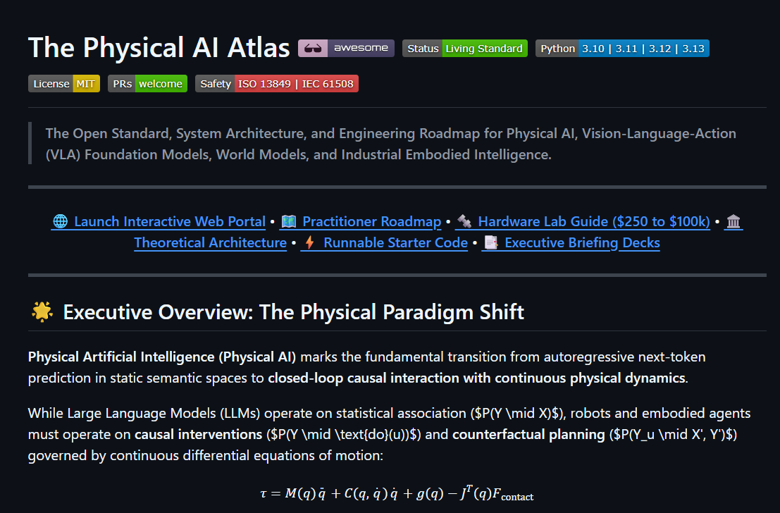
https://github.com/AK47-1845/physical-ai-atlas

